Slide 1
Binary Heap

Slide 2
Heap is a special case of balanced binary tree data structure where the root-node key is compared with its children and arranged accordingly.
A heap can be of two types −
Min-Heap
Max-Heap

Slide 3
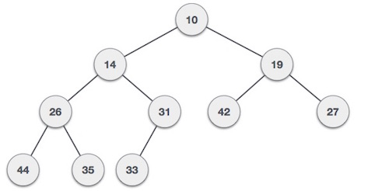
Min-Heap − Where the value of the root node is less than or equal to either of its children.
Example: For Input → 35 33 42 10 14 19 27 44 26 31

Slide 4
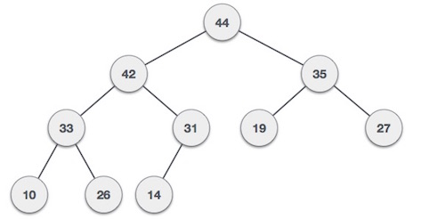
Max-Heap − Where the value of the root node is greater than or equal to either of its children.

Slide 5
CBT(Complete Binary Tree)
22,31,43,7,6,18,9 e.g: CBT
11- ACBT(All most CBT)
The heap has additional property all leaf should be at h or h-1 levels
Where h is the height of tree.

Slide 6
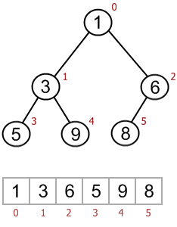
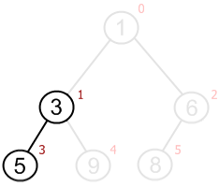
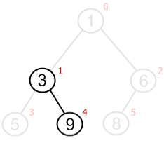
Heap array representation
Parent(i) = (i - 1) / 2
Left(i) = 2 * i + 1
Right(i) = 2 * i + 2

Slide 7
Array representation
20
13 9
8 5 3 7
6
Parent child
n 2n+1
(index) 2n+2
n-1/2← n
(childIndex-1)/2=parentIndex
20
13
9
8
5
3
7
6
2
1

Slide 8
Create heap using Array :
20,11,15,10,8,12
Insert 21

Slide 9
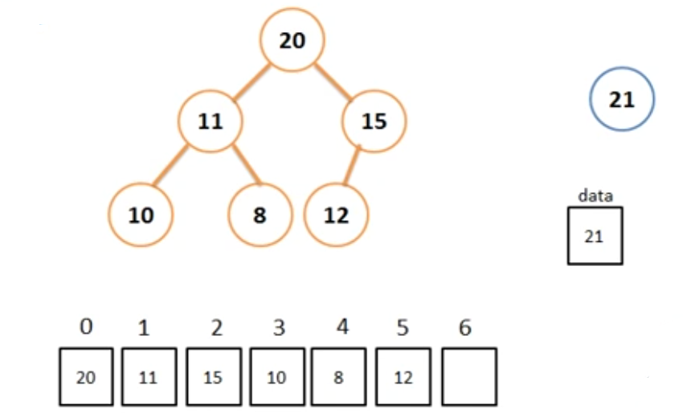
Insert operation in Binary Heap:

Slide 10
If(A[i-1/2]<data)
{
A[i]=A[(i-1)/2];
i=(i-1)/2;
}
A[i]=data;

Slide 11
Delete operation:
Deletion in Max (or Min) Heap always happens at the root to remove the Maximum (or minimum) value.
Step 1 − Remove root node.
Step 2 − Move the last element of last level to root.
Step 3 − Compare the value of this child node with its parent.
Step 4 − If value of parent is less than child, then swap them.
Step 5 − Repeat step 3 & 4 until Heap property holds.

Slide 12
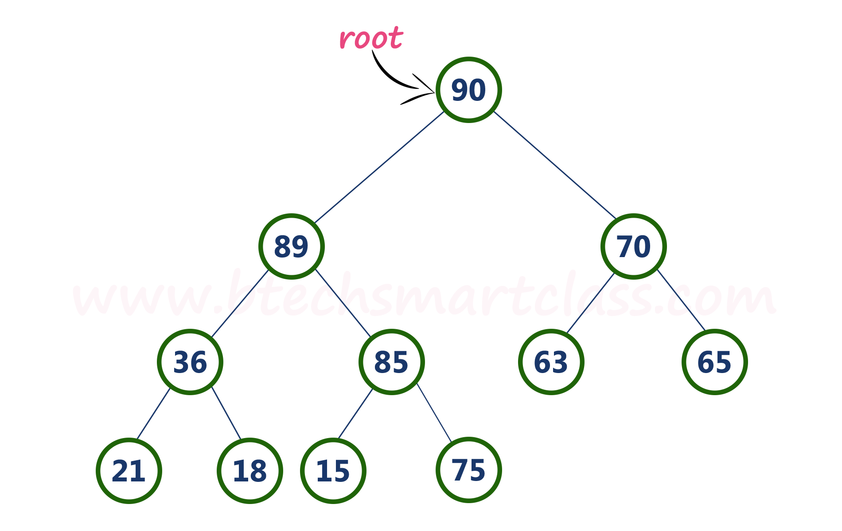

Slide 13
Consider the above max heap. Delete root node (90) from the max heap.

Slide 14
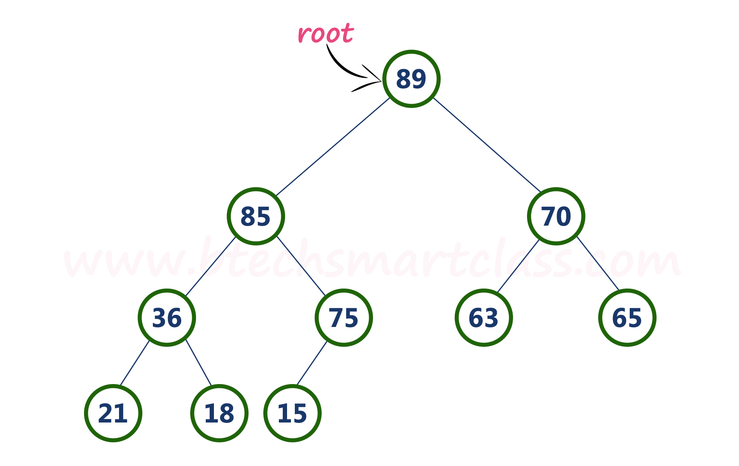
finally, max heap after deleting root node (90) is as follows...

Slide 15
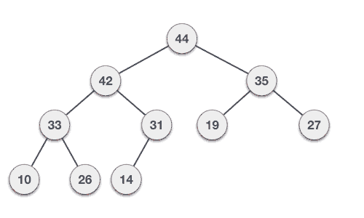

Slide 16
Priority Queue:
We know about Queue, where we insert an element from the back and remove an element from front but priority queue depends on the priority of the elements. Each element can insert or delete on the basis of their priority.
Higher priority > Lower priority
If element having same priority then go for FCFS

Slide 17
Types of priority queue:
Ascending Order( lower to higher)(1,2,3,4,5)
Descending Order(higher to lower)(5,4,3,2,1)

Slide 18
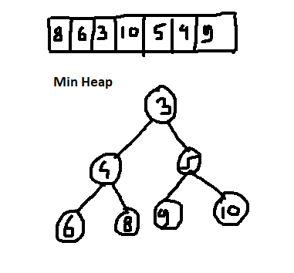
Smaller element = high priority

Slide 19
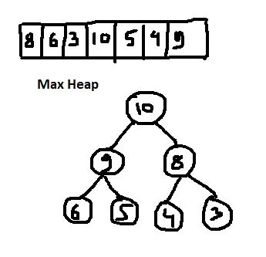
Large element= high priority

Slide 20
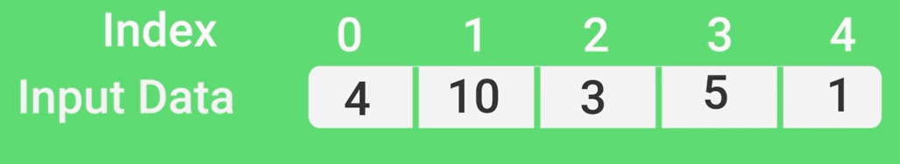
Heap Sort

Slide 21
Build heap
Create max heap
If not in ascending order then swap root with las and remove last

Slide 22

Binomial heap
A Binomial Heap is a collection of Binomial Trees that satisfies the properties of a min- heap.
What is a Binomial Tree?
Binomial coefficient :
Properties:
no. of nodes= 2^{k}
^{K=0,1,2,3,}

Slide 23
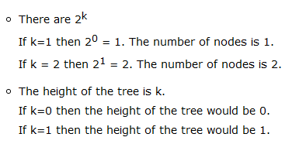
2. height(h)=k
3. nC₀= hC_{L}
=no. of nodes in level L

Slide 24

Now we have to determine the number of nodes:
if k is equal to 4 and at level L=2
No. of nodes=

Slide 25
4. The root has degree k and children of root are themselves Binomial Trees with order k-1, k-2,.. 0 from left to right.

Slide 26
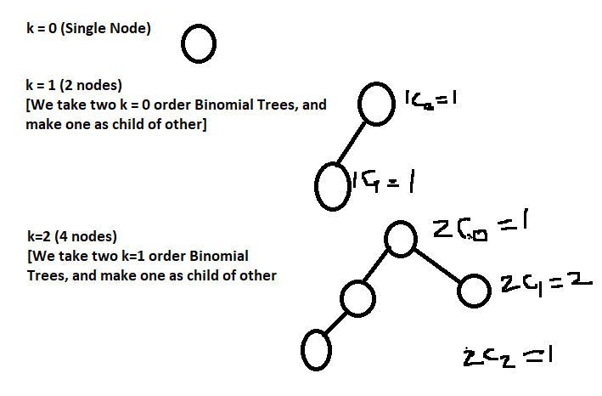

Slide 27
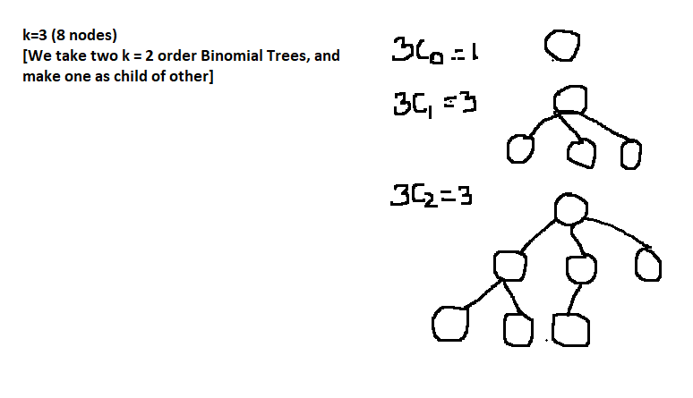

Slide 28
